Slide 1
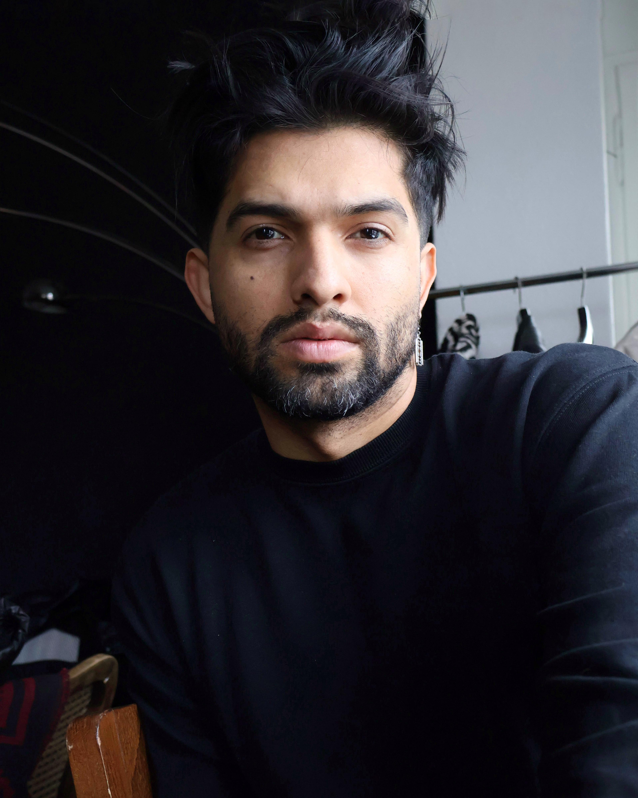





WORK EXPERIENCE
Superdry
Country Brand Visual Merchandiser Manager (2023 – Present)
- Spearhead the launch of new collections and innovative merchandising strategies. Design dynamic window displays and conduct comprehensive sales analyses.
Ralph Lauren
Brand Image Specialist (2023)
- Enforced brand guidelines and crafted compelling visual concepts for flagship stores.
Uniqlo Deutschland
Visual Merchandiser (2021 – 2023)
- Developed and implemented striking visual displays that reinforced the brand’s global identity.
Zara Deutschland
Visual Merchandiser (2021)
- Designed strategic display initiatives to boost sales and enhance customer engagement.
Diane & Geordie / Dugotex S.A.
Visual Merchandiser Analyst (2017 – 2019)
- Executed comprehensive visual merchandising strategies across 120 retail locations.
EDUCATION
Visual Merchandising
LCI University, 2018–2019
Comprehensive training in product presentation, strategic displays, and space optimization.
Architecture
Universidad La Gran Colombia, 2012–2014
Intensive program in theory and design with a focus on spatial recognition and diverse architectural styles.
High School Diploma
Liceo Samper Uribe, 2009–2011
Graduated with honors, building a solid foundation in both sciences and humanities.
EDUARD
BARRAGAN
Brand Visual Merchandiser Manager
PROFILE
Visual Merchandising professional with 9+ years of experience in brand management and retail design. As the Country Brand Visual Merchandiser Manager at Superdry, I oversee new collections and optimize product presentation. I have worked with leading brands such as Ralph Lauren, Uniqlo, and Zara, bringing expertise in Adobe Creative Suite, AutoCAD, and multilingual fluency in English and German.
SOFTWARE
PHONE
+49 1734249797
EMAIL
Eduardbocanegra1@gmail.com
WEBSITE
https://www.eduardbocanegra.com
ADDRESS
Erich-Weinert-Straße 76, 10439 Berlin
Adobe Creative Photoshop
Adobe Creative Illustrator
Microsoft Office package
AutoCAD
Microsoft Office Suite
SketchUp
V-ray
ADDITIONAL COURSES & CERTIFICATIONS
Adobe Illustrator & Photoshop
Product Design & Development
Technical Training in Blackwork
Window Display & Visual Marketing
Image & Photography for Graphic Production
Creative Styling
English Proficiency – Advanced fluency (DOT Levels 1-9).
German Proficiency – Certified at SprachHaus Level B2.
LANGUAGES
English: Professional
proficiency (B2/C1)
German: Intermediate B2
Spanish: Native proficiency

